Slide 1
Photoshop: Intro to Advanced skills
by Sean O'Mahoney

Slide 2
Content
Uses
Navigation/Shortcuts
Panels
Basics (Generic Shortcuts)
Layers
Text
Brushes
Paths
Practical's

Slide 3
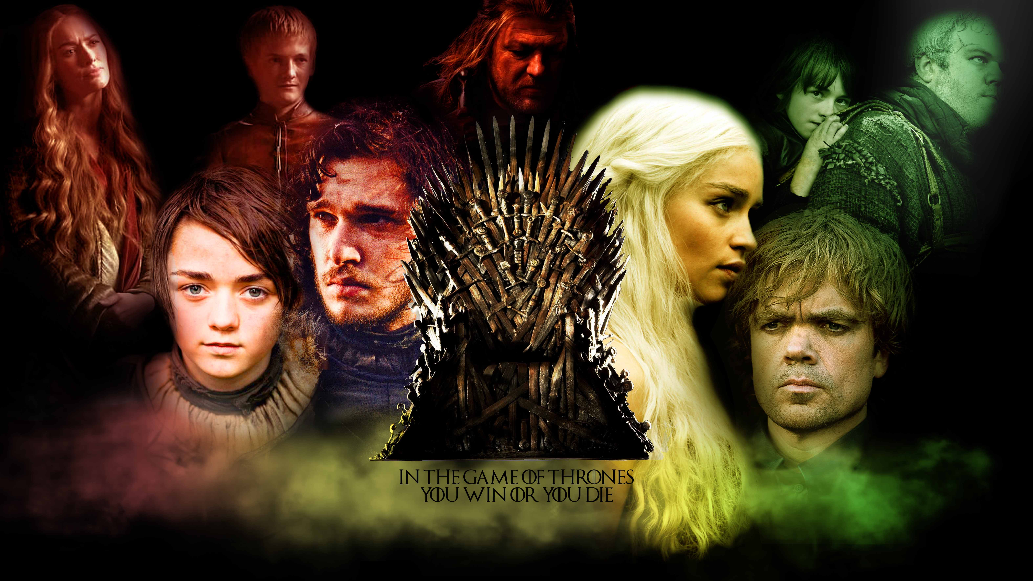

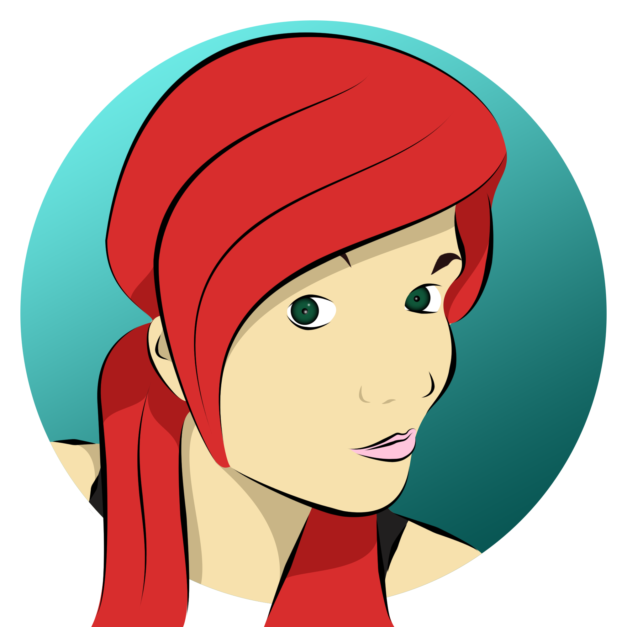
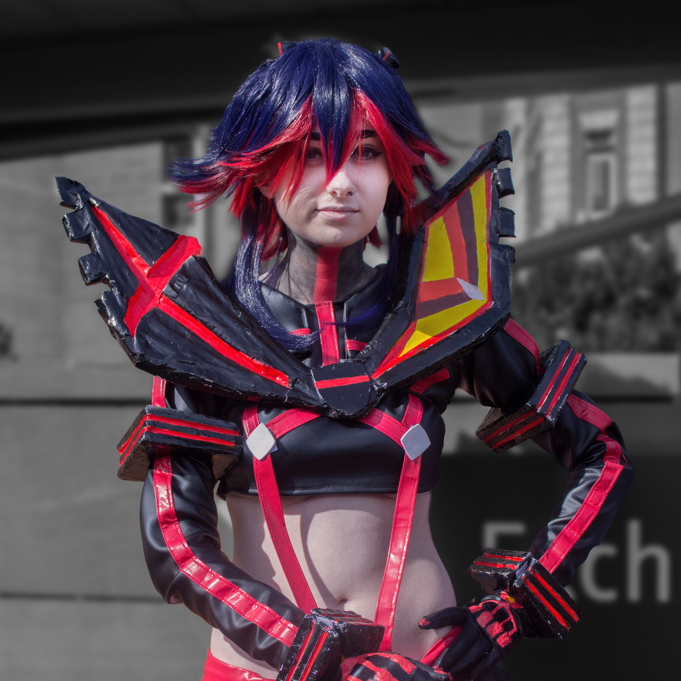

Photoshop Uses
Photoshop is used for a myriad of reasons:
Photo Manipulation (Composition)
Graphics Design
Digital Art
Animation
3D rendering
and even more…
Examples done by me (Sean) in Photoshop

Slide 4
Beginning Navigation/Shortcuts

Slide 5
Basics
New document: File > New… (Ctrl+N)
Open: File > Open… (Ctrl+O)
Zoom in/out: View > Zoom In/Out (Ctrl+Alt+Scroll / Ctrl + ”+/-”)
Fit to screen: View > Fit on Screen (Ctrl+0)
Select > All (Ctrl+A)
> Deselect (Ctrl+D)
> Inverse (Shift+Ctrl+I)
Invert colours (Ctrl+I)

Slide 6
Brush
Brush: 8th Tool (B)
Increase Size: “[“
Decrease Size: “]”
Increase Hardness: “Shift+[“
Decrease Hardness: “Shift+]”
Change Opacity: 0-9 (0 = 100%, 1 = 10% - 9 = 90%, fast tap for increment, 55 = 55%)
Advanced Settings: F5

Slide 7
Layers
New layer: Shift + Ctrl + N
Group layers: Ctrl + G
Ungroup: Shift + Ctrl + G
Merge All Layers: Ctrl + E
Merge All Visible Layers: Shift + Ctrl + E

Slide 8
Text
[Lets switch over to Photoshop]

Slide 9
Paths
To get Direct Selection tool while using Pen -- Ctrl
Switch between Add-Anchor and Delete-Anchor Point tools (if one of those tools is selected) -- Alt
Switch from Path Selection tool to Convert Point tool when pointer is over anchor point -- Ctrl-Alt
To Select a whole path w/Direct Selection tool -- Alt-Click
Convert path to a selection -- Ctrl-Click on path name (in Paths panel)

Slide 10
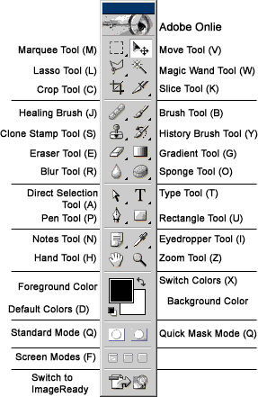
Tools
Go over and revise this chart if you wish, although you will learn easier with using Photoshop, which we will be doing next and revisiting these shortcuts in the practical’s following…
Chart by NewTutorials from this article

Slide 11
Small Practical's

Slide 12


Resizing
This shortcut is very useful for changing the canvas size (dimensions in pixels), which can be used in Website Development, to decreases the file size of images (where needed), to optimise the sites load time.
Image Size: Image > Image Size… (Alt+Ctrl+I)

Slide 13
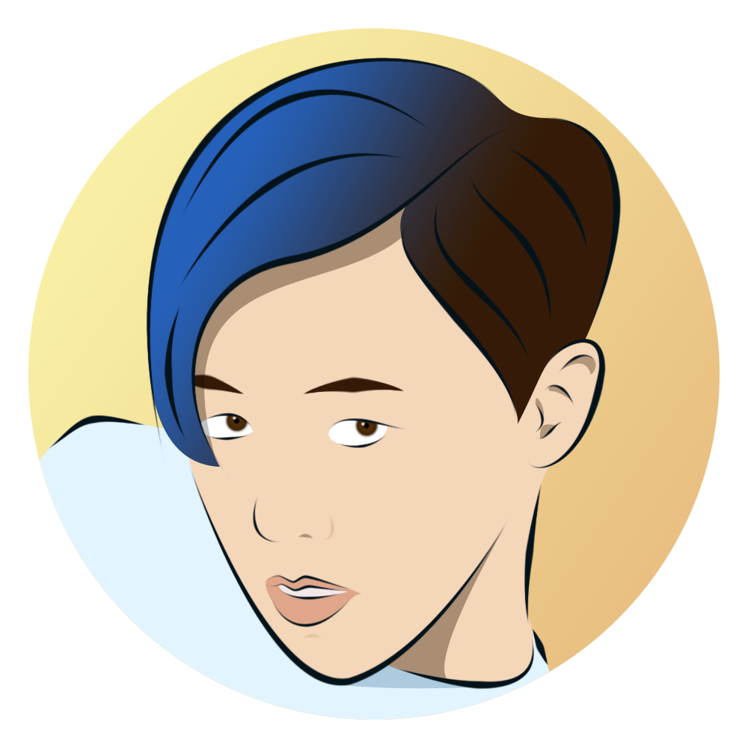
Centred Circle (1 of 3+ Methods)
Show rulers: View > Rulers (Ctrl+R)
Show guides: View > Show > Guides (Ctrl+;)
Pallet (shortcut “D” for default Black foreground and White background)
Ellipse: on the toolbar (U), Shift + Tool Shortcut, to cycle through different versions
Marque tool: “M”
Hold “Alt” to centre
Hold “Shift” to keep portions

Slide 14
Practical's (Pt. 2)

Slide 15
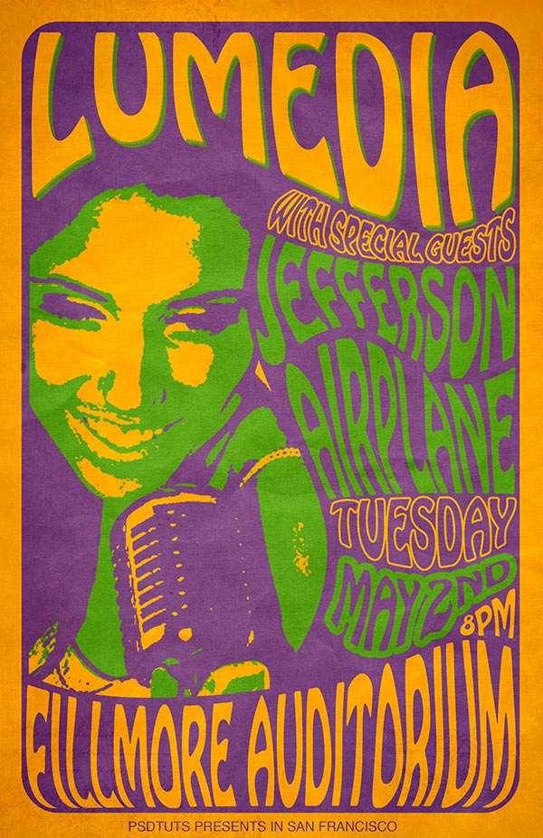
60’s Psychedelic Style Concert Poster
https://design.tutsplus.com/tutorials/create-a-60s-psychedelic-style-concert-poster--psd-183

Slide 16

Simple Illustrations
https://www.facebook.com/pg/Sean12697/photos/?tab=album&album_id=1671853236399377

Slide 17
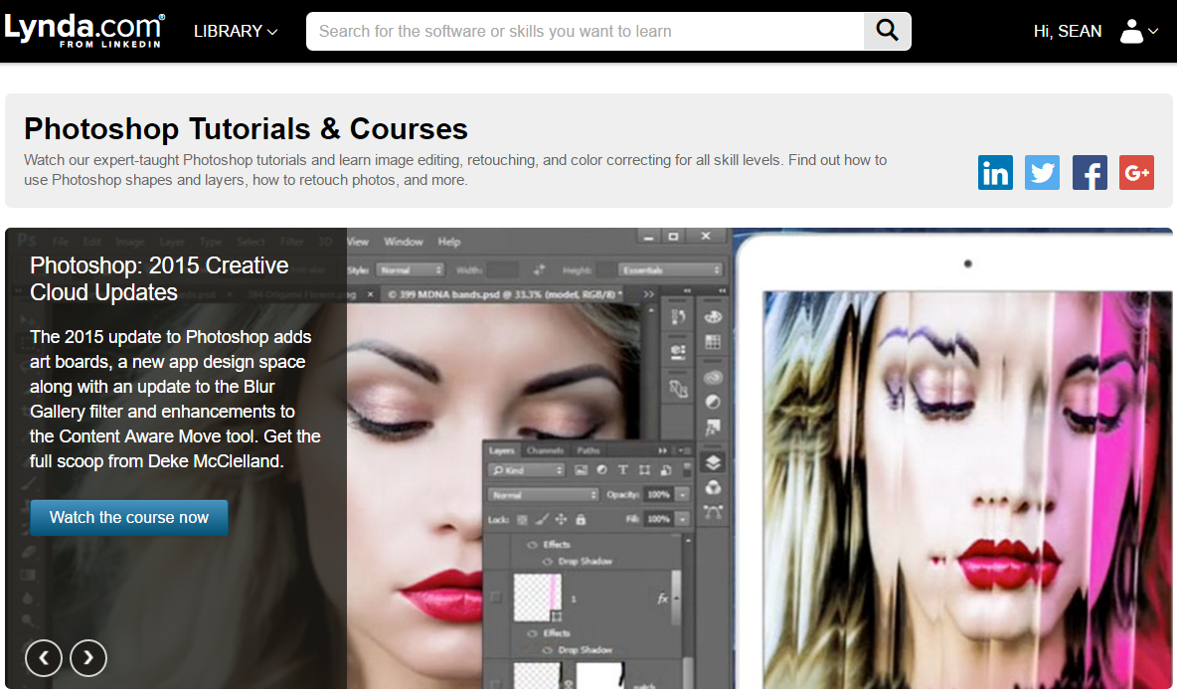
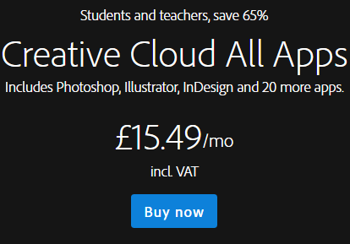
Round up
Today we have gone over a few of the shortcuts for Photoshop (including their locations in Photoshop UI/Navigation Bar), as well as have used them in practical situations, which you might be finding yourself using the tools for also.
I will leave relevant links to the right, which you can either take a picture of whiles it‘s being presented, or you could download this presentation, which I will share to the group and event.
https://www.lynda.com/Photoshop-tutorials/279-0.html
http://www.adobe.com/uk/creativecloud/buy/students.html

Slide 18
Thank You
Sean O'Mahoney
sean.omahoney@stu.mmu.ac.uk
Computing Society
Facebook: “MMUComputingSociety”
Twitter: @MMUComputingSociety
Union: Computing Society

